Slide 1
“Analysing the Suitability of Neighbourhoods in New York for Young Families to Live In”
Joe O’Reilly
23.03.2021

Slide 2
INTRODUCTION
The aim of this project is to find the most suitable neighbourhood in New York for a family with young children to live in. The neighbourhood should have some amenities that the parents would benefit from as well as some amenities for the children to avail of.
PARENT’S AMENITIES | CHILDREN’S AMENITIES
BAR PUB RESTAURANT | A SPORTS CLUB A PARK A PLAYGROUND A TOY / GAME STORE A MOVIE THEATRE (CINEMA)

Slide 3
DATA SOURCES
GEOSPATIAL DATA
The Geospatial data containing neighbourhoods in New York City (including their latitude & longitude) were sourced from a json file.
https://cf-courses-data.s3.us.cloud-object-storage.appdomain.cloud/IBMDeveloperSkillsNetwork-DS0701EN-SkillsNetwork/labs/newyork_data.json
VENUES/ AMENITIES DATA
The Foursquare API was used to gather information on the amenities close to the coordinates of each neighbourhood taken from the json file.

Slide 4
DATA FILTERING
REDUCE COLUMNS
We filtered the returned Foursquare data firstly to only include the amenities that we are interested in for our study.
This dramatically reduced the width of our dataframe.
REDUCE ROWS
We filtered the updated dataframe to ensure that it includes only neighbourhoods that met the minimum requirements as outlined in the problem statement.
This dramatically reduced the length of our dataframe.

Slide 5
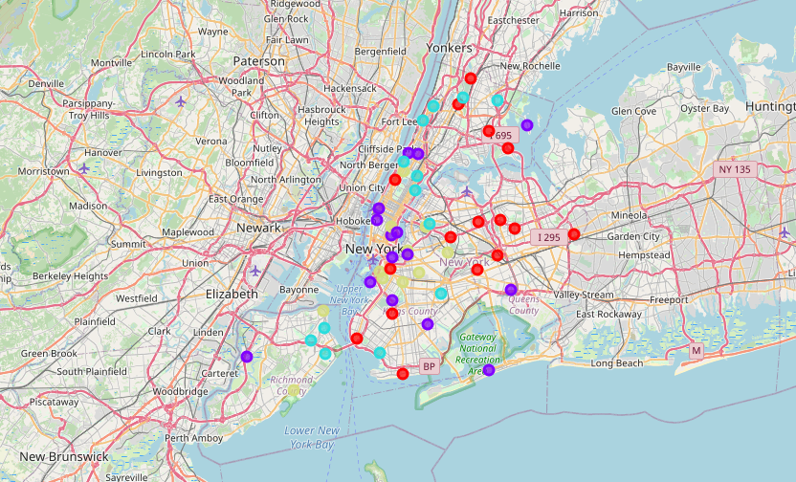
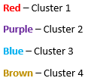
DATA ANALYSIS
CLUSTERING
We performed K-Means clustering to group the suitable neighbourhoods into 4 groups/ clusters.
The neighbourhoods were then mapped using folium, using marker colour to distinguish between clusters.

Slide 6
CONCLUSIONS
It is clearly visible from the folium generated map, that there are many neighbourhoods in New York City that meet the minimum requirements outlined to raise a young family. These neighbourhoods are in all areas of the city (North, East, South and West).
There are 54 suitable neighbourhoods in New York City that meet the minimum requirements to raise a young family. Of these 54 neighbourhoods, the 19 that were grouped in cluster 3 appear to be the most suitable in my opinion, for the reasons already outlined below
Large number of Bars (for adults)
Large number of Parks (for children)
There are a relatively large number of neighbourhoods in this cluster group (19).

Slide 7
FUTURE STUDY
The initial analysis presented for this project does not consider house prices in the analysis. However, it may be worth including another dataset containing historical regional house price data, as that would obviously have a big impact on the decision of which neighbourhood to live in.

